Slide 1

Think Big Session
24 de Agosto 2016
Buenos Aires

Slide 2

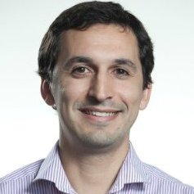

SPEAKER
Presenting Today:
Joaquin Moreno
Blockchain Practice Lead
at Globant
@joaquinmoreno

Slide 3

Intro
Which problem does it solve?
How does it work?
Blockchains
Applications
The blockchain race
Use cases
A glimpse into the future
What we are doing at Globant

Slide 4
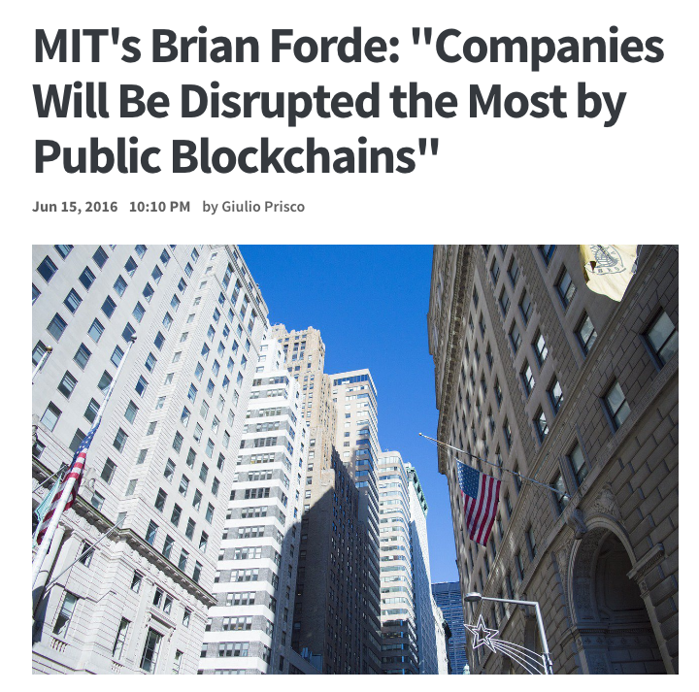
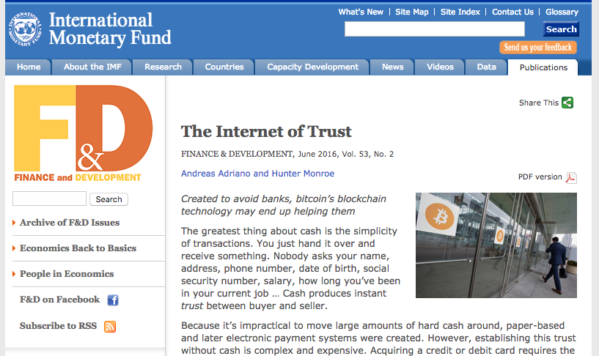
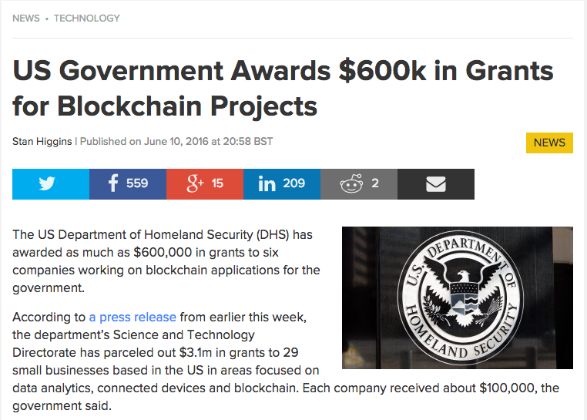
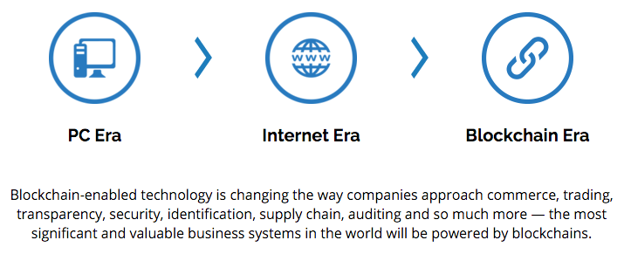
News

Slide 5

Which problem does it solve?

Slide 6
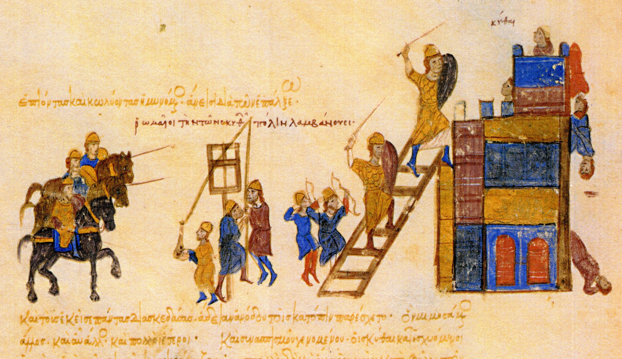
Byzantine General Problem

Slide 7
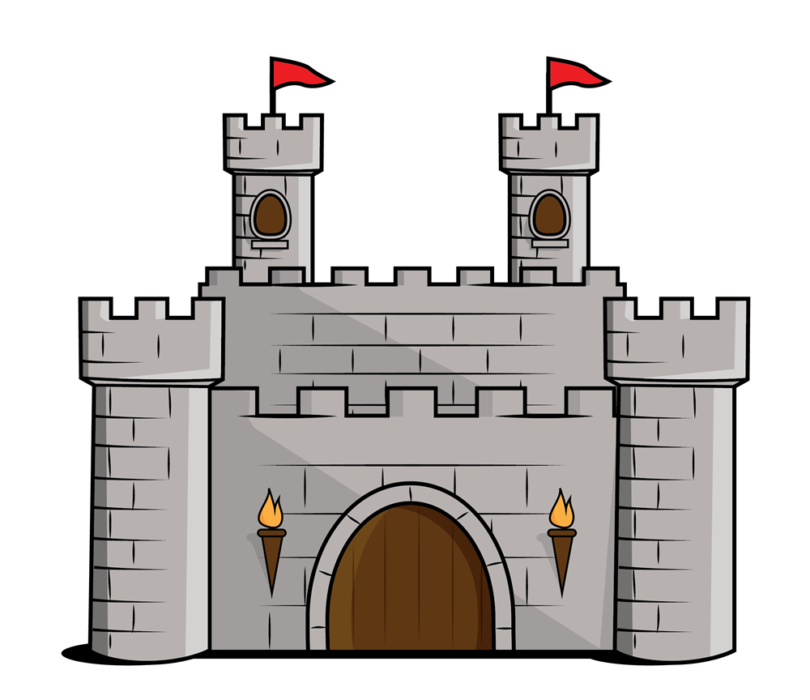
100
100
300
Attack 9pm
Attack 8pm
100
100
100
100
Attack 9pm
Attack 8pm

Slide 8
2 Simple Rules
Add the previous message to your message.
It takes 10 minutes to write the message.
100
100
300
Message 1:
Attack 9pm
100
100
10 min
100
Message 2: Attack 9pm + Message 1
Will it change the message?
No.

Slide 9

2) Double Spend

Slide 10
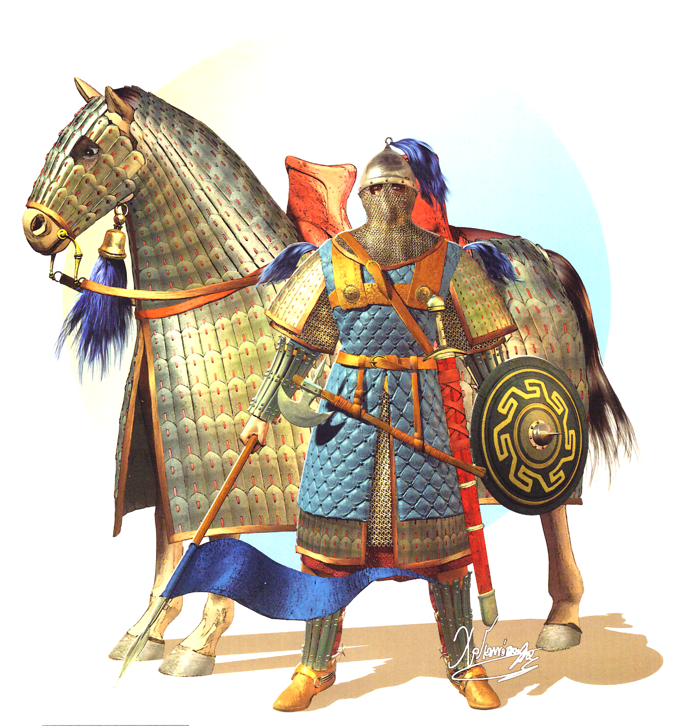


Byzantine
General Problem
Source of
Truth
2) Double Spend

Slide 11

Fuente de
Confianza
Mathematics
Notes:
Entonces surgen 2 preguntas…
La primera es, genial, este sistema es una fuente de confianza, pero el sistema, ¿en que se basa para que funcione de forma confiable?.... y la respuesta es… en las matemáticas. Porque? porque todas las técnicas criptográfica que se utilizan utilizan las matemáticas para resolverse. Los sistemas de consenso dentro de la red utilizan lógicas matemáticas para validar si una transacción o bloque es válido.
La segunda pregunta que surge es:
¿Para que puedo utilizar esta base de datos que es segura, inmutable y actúa como una fuente de confianza?
La respuesta está aún en proceso… porque? porque a medida que pasa el tiempo se van descubriendo nuevas utilidades.
De todas formas, veamos algunos ejemplos… [PROXIMO SLIDE]

Slide 12

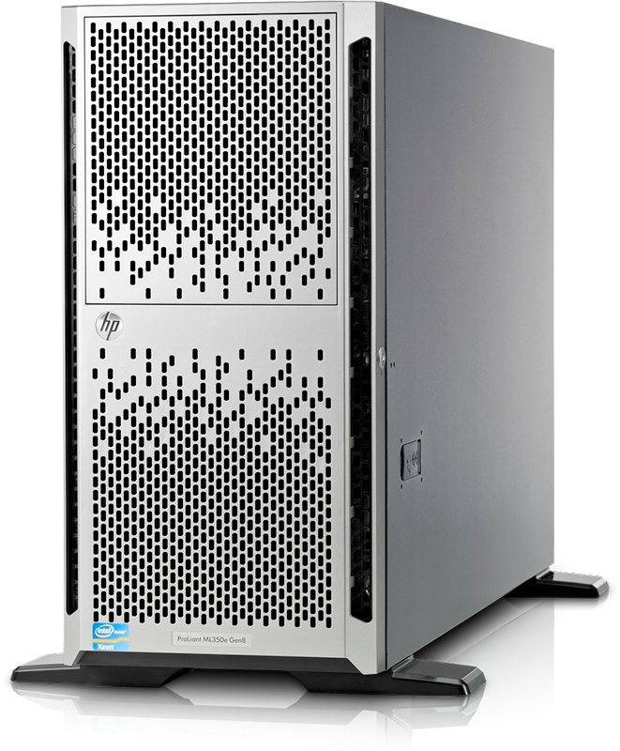

COMMUNICATIONS

Slide 13
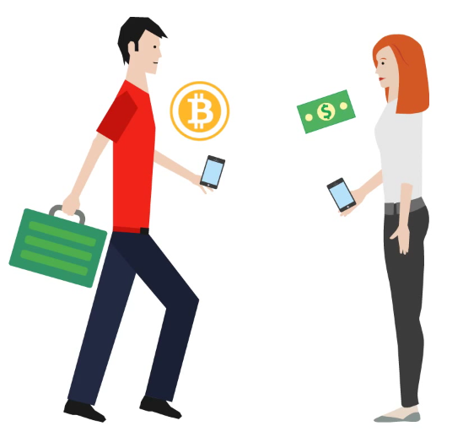
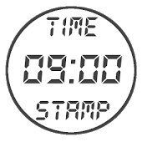
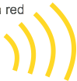
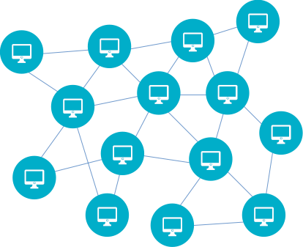

Transaction
Broadcast
Propagation
Validation
Blockchain
Proof of Work
Input
Amount
Output
Metadata
HOW DOES IT WORK? (Basics-Bitcoin)
10 min

Slide 14
POWER IN BITCOIN BLOCKCHAIN
161.000
2
Sunway TaihuLight
125 Petaflops/s (Peak)
Top 10 Supercomputers
282 Petaflops/s (Peak)
Bitcoin = 161,000 Sunway TaihuLight
20,233,393 Petaflops/s, Aug 24th 2016
Sources: http://www.top500.org/lists/2016/06/ | http://bitcoinwatch.com/
Notes:
Sunway TaihuLight (publicado el 20 de Junio de 2016). Source: http://www.top500.org/lists/2016/06/

Slide 15

Blockchain(s)
Notes:
Please, If you have any question remember to send them over the webex chat.
blockchains on the market + applications + what we are doing here at Globant.
Interesting (source: Guideon Greenspan -Multichain-): “blockchains are ideal for shared databases in which every user is able to read everything, but no single user controls who can write what. By contrast, in traditional databases, a single entity exerts control over all read and write operations, while other users are entirely subject to that entity’s whims. To sum it up in one sentence:
Blockchains represent a trade-off in which disintermediation is gained at the cost of confidentiality.”

Slide 16
INVESTMENTS
Total Global Funding to Blockchain/Bitcoin Companies
$93 M
$993 M
Funding Between
2009-2013
Funding Between
2014 and Feb 18th 2016
Source: CBInsight. https://www.youtube.com/watch?v=75YknrdY7Yg
Notes:
As Juan mentioned before, Bitcoin > 1st blockchain > opened the door to a new generation of blockchains.
“Talk about” “Blockchain” [CHANGE SLIDE]

Slide 17

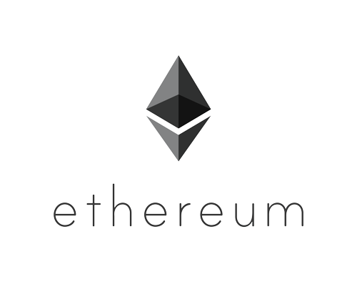
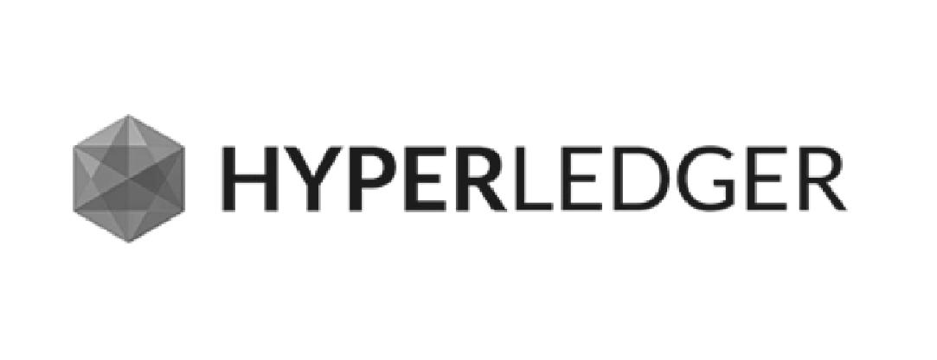
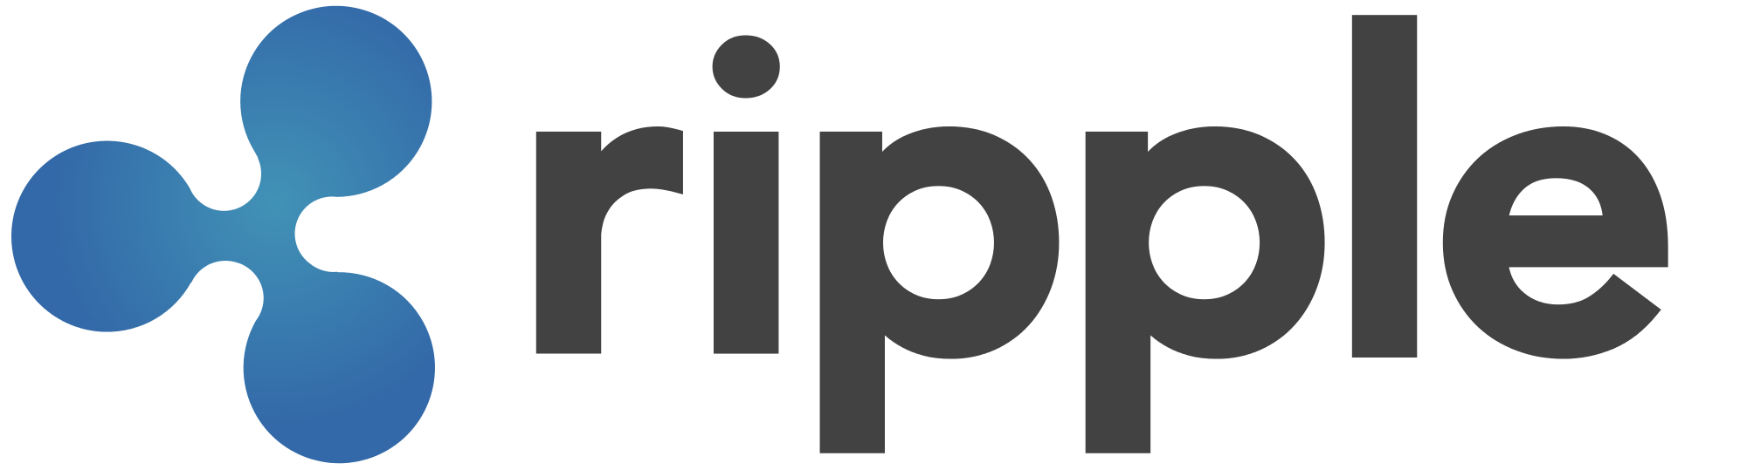



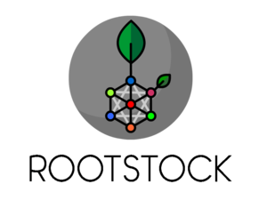
Sidechains
Corda
OTHER BLOCKCHAINS
BTC
Notes:
A brief overview.
Ethereum > most prominent blockchain > open source > smart contracts from the ground up + only Touring complete system.
SideChains > blockchain systems > connected > Bitcoin blockchain > Example: 1 btc is equivalent to 100 tokens > own business and consensus rules.
Eris (smart contract platform) > permissioned so it became a good option for banking solutions.
R3CEV is a consortium of +40 banks and they are working on a solution for the inter-banking communications problems. At the beginning of the year, they made a test with 5 blockchains and they finally decided to make their own solution called Corda, that is not a blockchain per-se but a solution inspired by the blockchain technology.
Hyperledger > open source (Linux Foundation). > permissioned distributed ledger > well defined governance model (with governing board, technical Steering Committee and a community of developers). > is designed to be both as modular and extensible as possible in order to accommodate these future unknown developments.
Ripple network > finance industry > on the market for 4 years > exchange value between the participants of the network. Last week (April 21st), the MIT announce a partnership with Ripple to move their research from the blackboard to the real world.
Tendermint > modular architecture for blockchain development, (so that new blockchains, permissioned or public, can be built in any language)
Tau-chain is a very promising concept. It’s a fully decentralized P2P network being a generalization of many centralized and decentralized P2P networks.
real world problems and let`s talk about the applications [CHANGE]

Slide 18

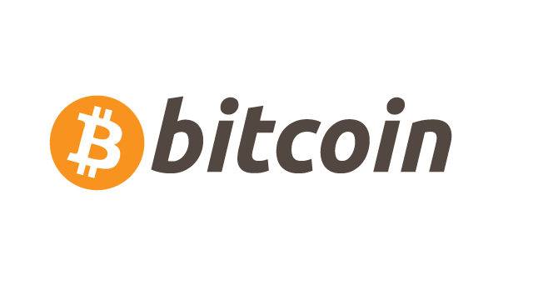
Corda
Logic Optimized
BLOCKCHAINS QUADRANTS
ETHEREUM
Unpermissioned
Permissioned
Alt-Coins + Sidechains
Transaction Optimized
Original Base Source: https://docs.erisindustries.com/explainers/blockchains/
Notes:
Hyperledger: allows both permissioned and permissionless blockchains to be created from its core, although we expect permissioned blockchains to be the initial focus.

Slide 19
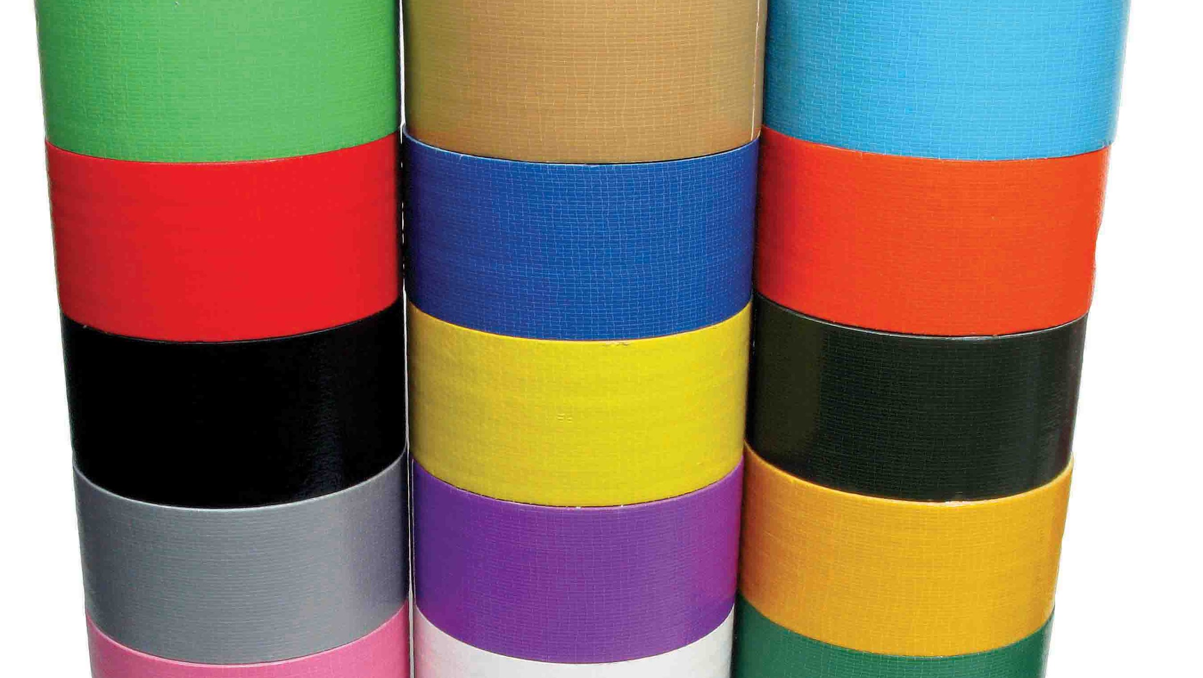
APPLICATIONS

Slide 20
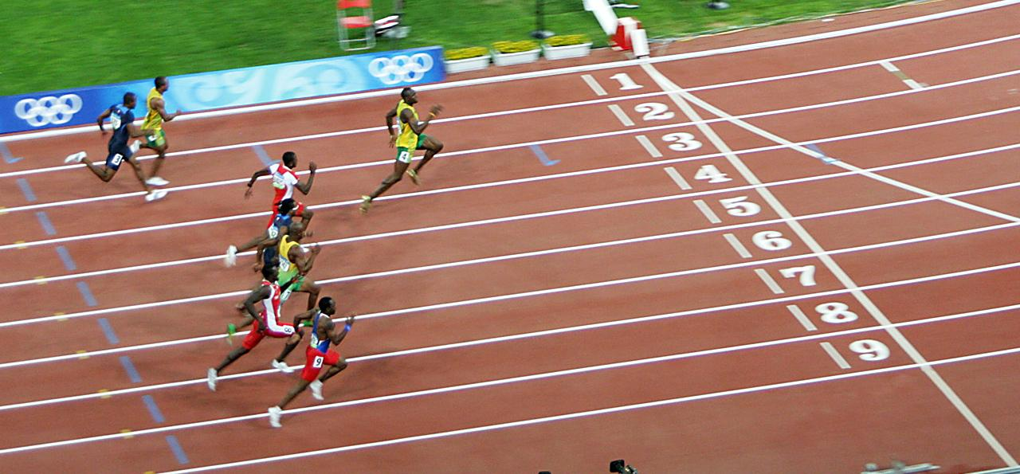
Gaming
Legal
Finance (Settlements, trading)
IoT (Identification & Communication between devices)
Energy (Efficiency)
Credential Certification (Universities, Trainings)
Asset Legitimacy (Art, Jewelry, etc.)
Logistics (Tracking)
Blockchain Race
Notes:
Before going into detail about each of the applications, this is a simplified overview of what I call the Blockchain Race.
Leading the Race we have the Finance industry, later we´ll talk about why this is happening, then we have a batch of other industries….

Slide 21






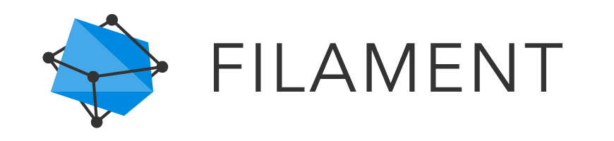







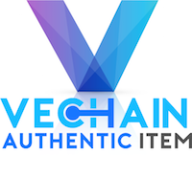
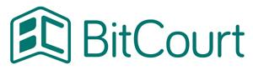

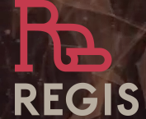
Clearing & Settlement
Internet of Things
Smart Contracts
Asset Legitimacy
Inheritance
Employees
Logistics
Legal
Wines
Jewelry/Art
Land
Electronics
Generics
APPLICATIONS IN DIFFERENT INDUSTRIES
Notes:
Clearing & Settlements
(23-Jun-16) Mizuho Tests Digital Currency-Powered Settlement: Using its own virtual currency that trades 1:1 with the Yen in a secure environment could potentially provide better tracking and control of the exchange of funds, and eliminate some of the expenses associated with the exchange of paper-based currency.
(23-Jun-16) Test de Dutch Central Bank (De Nederlandsche Bank (DNB): Berndsen named blockchain's potential to impact all three of its "primary tasks": to promote the smooth functioning of the payment system, provide supervision and oversight and inform monetary policy. Before central banks can adopt blockchain, Berndsen named interoperability, industry fragmentation and self-interest among financial incumbents as three barriers that need to be overcome.
Internet of Things
IBM and Samsung > own system called ADEPT (Ethereum). Example: a fridge > local store or the repairman.
Slock.it is > Door Lock system > (Ethereum). Example: Airbnb
Filament (Blockchain) > devices to collect different kind of information. identify each of the devices and avoid any kind of malicious communication between them.
Smart Contracts
Some Applications: Inheritance, Employees, Logistics and Legal
In Logistics or Supply-chain management, smarts contracts could save millions. The International Chamber (chainber) of Commerce > (counterfit) and pirated products > US$1.77 trillion in 2015.
Wave > peer-to-peer and completely decentralized network > connects > all carriers, banks, forwarders, traders and other parties of the international trading supply chain. Communication > direct and without a central authority.
Open Trade Docs >a private blockchain > participants remain in control of all data and access rights.
Skuchain > to track any type of product, throughout every part of its lifecycle.
(Próvenance) > Bitcoin and Ethereum > mark of trust > from source to consumer.
VeChain = (Próvenance)
BitCourt > legal disputes between parties > using an scrow.
Asset Legitimacy
Uses: Wines, Juwulry, art, land, electronics and generics.
Jewelry [JUWULRY]/Art: > Blockverify and ascribe
Lands > The government of Sweden is testing a system for registering and recording land titles that utilizes blockchain in a bid to digitize real estate processes. (Swedish company ChromaWay AB) - ColoredCoins
Generics > Factom (blockchain) and Regis (Ethereum) creat your own registry system. Example: Race-horses / Timbers / lands.

Slide 22







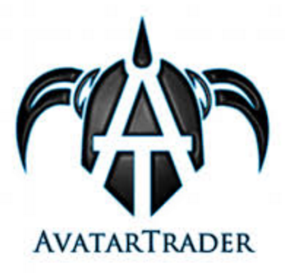


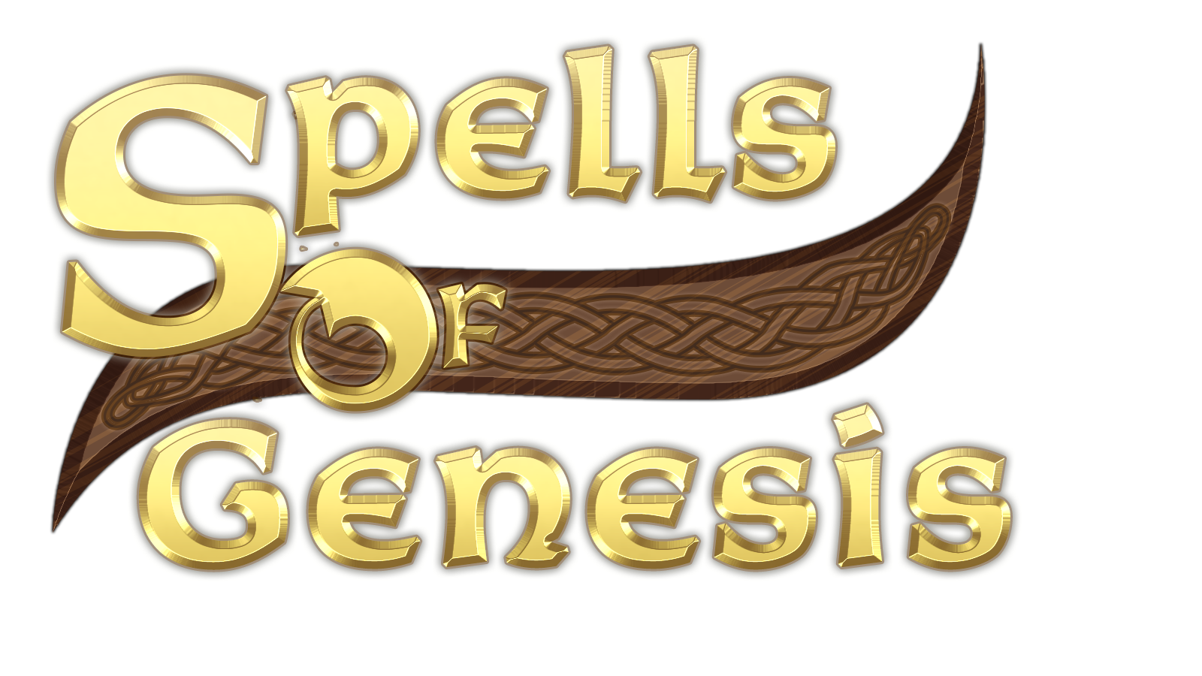


Energy
Identity
Credential Certification
Gaming
APPLICATIONS IN DIFFERENT INDUSTRIES
Notes:
Energy
LO3 Energy (US) (Ethereum) > Use case: Trade Solar Energy (11th April - 1st transaction)
Electron (UK) > User Case: increase the competition and the transparency + they are planning create a ledger of record for energy use.
Slock.it (germany) + RWE (one of the biggest power supply companies in Germany) Use Case: network of car electric chargers. (Ethereum)
Identity
Onename > Use case: create usernames and user data is embedded directly into the blockchain.
Banquapp > eliminate the poverty in the world > creating an economic identity to the users (bitcoin).
ShoCard > digital identity that protects consumer privacy and is as easy to understand and use as showing a driver’s license.
Credential Certification
MIT Media Lab > certificates to their students (bitcoin)
Sony Global Education (since Feb 16) > Open Sharing of Academic Proficiency and Progress Records.
Holberton School (project-based alternative to college) > User case: paper + digital (Bitcoin)
Gaming
Spells of Genesis (own cryptocurrency called BitCrystals (BCY)) > use case: purchase game items or traded with other players.
AvatarTrader > platform > gamers > exchange theirs avatars in a safer way.
Ownage (Ethereum) > Use Case: to distribute, collect and trade digital game content.
As you might imagine > several others user cases > not discovered yet.
Let´s take a look to what we are doing here at Globant...

Slide 23






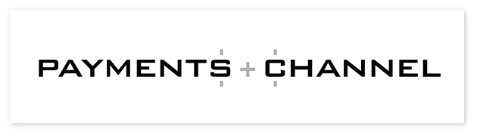

Healthcare
Insurance
Insurance valid.
Payments
Private Quotations
Mutual Insurance
Medical
Records
Media / Marketing
Governance
Copyrights
Payments
Votation
DAO
APPLICATIONS IN DIFFERENT INDUSTRIES
Notes:
Healthcare
Tieron: platform for timestamp medical record on the blockchain. Developed an open standard (Chainpoint) for recording data in the blockchain and generating blockchain receipts. (contains all the information needed to verify the data without relying on a trusted third party). They partnered with Philips.
Philips: (Philips Blockchain Lab) with Gem they seek to build out a private Ethereum blockchain for use in the development of enterprise healthcare applications.
Insurance
PwC: to launch a research project that will investigate the potential of blockchain tech in the wholesale insurance industry through a survey and proof-of-concept prototype. The study, involving a global survey of the industry, will aim to identify "priority business use cases" and develop a roadmap for future blockchain developments, according to the statement. Both the study and the proof-of-concept are expected to be completed in July. (Source:http://www.coindesk.com/pwc-investigate-blockchains-potential-wholesale-insurance/)
Media / Marketing
Copyrights:
monegraph: platform for register and selling digital content rights (Sales processed through our platform fee: $0.60 + 9.5% of the sale amount. Includes stripes ang blockchain process). Based on Bitcoin
Ascribe:
Payments:
UJO Music (open source platform - from UK - Uses Ethereum platform to create payments accordingly with a smart contract) +
Payment channel: (money as a liquid)
More information about music >> https://bitcoinmagazine.com/articles/three-startups-trying-to-transform-the-music-industry-using-the-blockchain-1447444594
Governance
Votation: >>> Tezos
DAO: (Descentralized Autonomus Organization = Is a type of Descentralized Application which incentivises its user to engage in activity which furthers its agreed business objectives by enabling them to work together without requirem them to trust each other. Source: https://www.youtube.com/watch?v=cYwaGQg1mYY)
Colony is a platforms that allows anyone to create a DAO.

Slide 24
POSSIBLE SCENARIOS
regulated products
Finance
non-regulated Products
contracts between devices (IoT)
IoT
Device ID Registration
regulated products
Healthcare
non-regulated Products
payments from customers
Other Industries
Internal processes
2016
2017
2018
2019
2020
Most Likely to be Implemented
Notes:
Healthcare: also consider “privacy”.

Slide 25
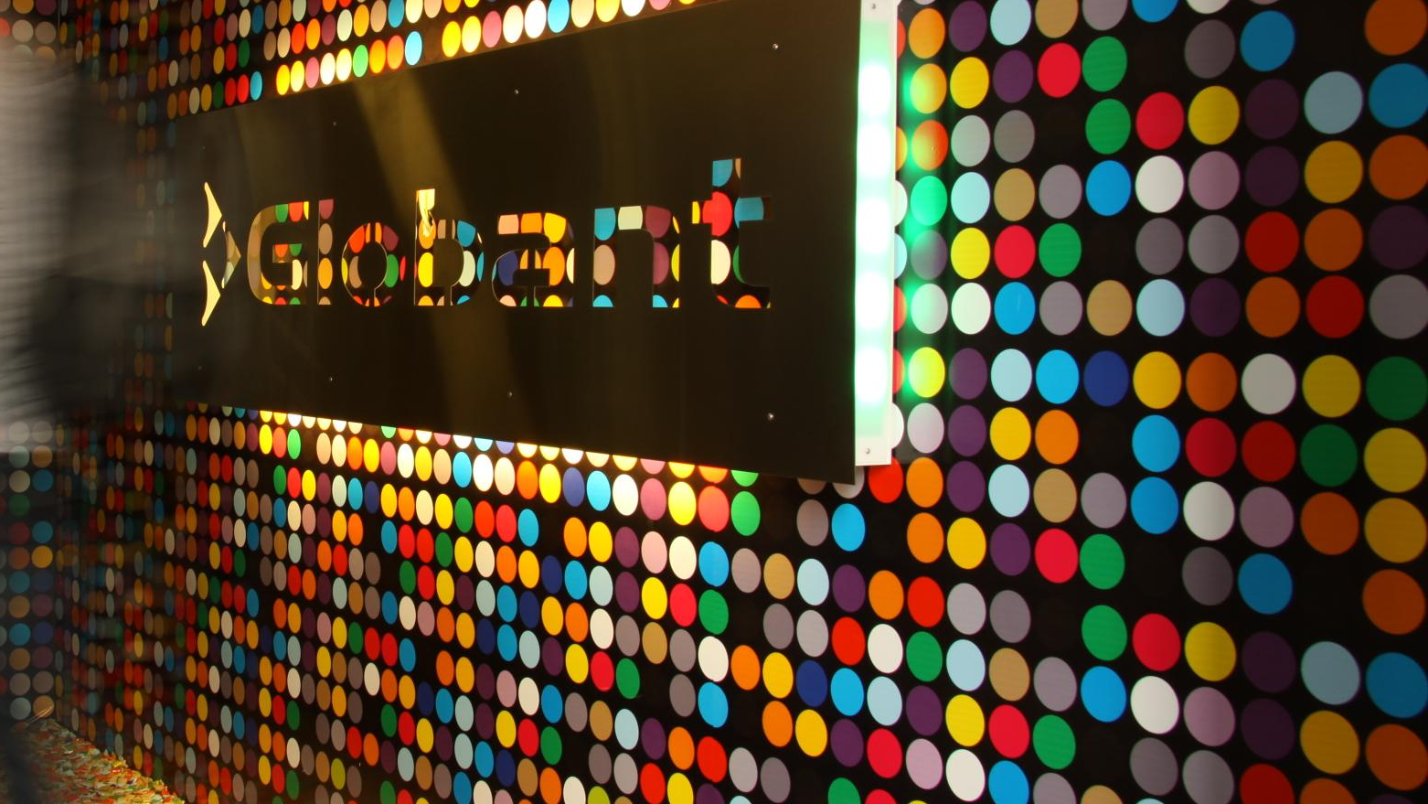
What are we doing?

Slide 26
Vision and Team
Have an eye on it
Core Dev-Team
Stand-by
Interested/Learning
OpenBazaar
Focus
Factom
Lucas Ontivero
James Baker
Cesar Martinez
Octavio Velasco
Samuel Quintana
Emmanuel Nava
Victor Amaya
Emanuel Diaz
Gabriel Medina
+6 globers
Rootstock
Bitcoin
Ripple
Storj.io
Ethereum
Others
Hyperledger
Lightning
Networks
+25 globers
Counterparty
Learning Material: https://sites.google.com/a/globant.com/bitcoin/

Slide 27
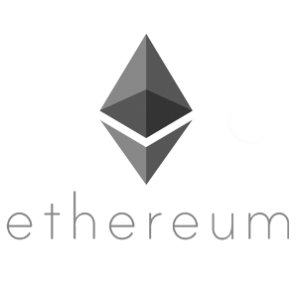

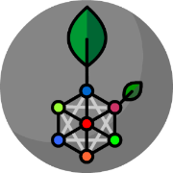




TECHNOLOGIES
Some of the Technologies under research
Rootstock
BTC
Sidechains
At Globant, we are technology agnostics, so we are able to implement the best solution to each problem.
Globant Proprietary | Confidential Information
Notes:
Present confidence:
Show our Experience and Capacity.
What do we see happening on the industry.

Slide 28
EXPERIENCE
Mobile Device Registration System
Problem
Fake mobile devices and robbery on the market.
Benefits
Customers can buy an original mobile device from the real owner. A robbed mobile device cannot be sold.
2) Digital Assets Management
Problem
Inefficient and expensive to maintain database.
Benefits
By using a blockchain technology the settlements and approvals are faster, the transactions and maintenance costs reduced.
3) Access Management Mobile App
Problem
Manage access to an specific building area for personnel and visitors.
Benefits
More reliable database. Easy traceability and audit
4) Custom Blockchain System
Problem
Improve digital assets and tokens management in a complex system.
Benefits
Faster settlements.
Assets management is more secure and auditable.
Globant Proprietary | Confidential Information

Slide 29
EXPERIENCE
5) Audit Trial System
Problem
A hacker corrupt a traditional database.
Benefits
Fast and easy way to realize if an unwanted change is done on the Database.
6) Certification
Problem
Counterfeit certificates. Difficult to verify.
Benefits
Easy way to verify if a certificate is real or not by saving the information on the Bitcoin blockchain.
Globant Proprietary | Confidential Information

Slide 30
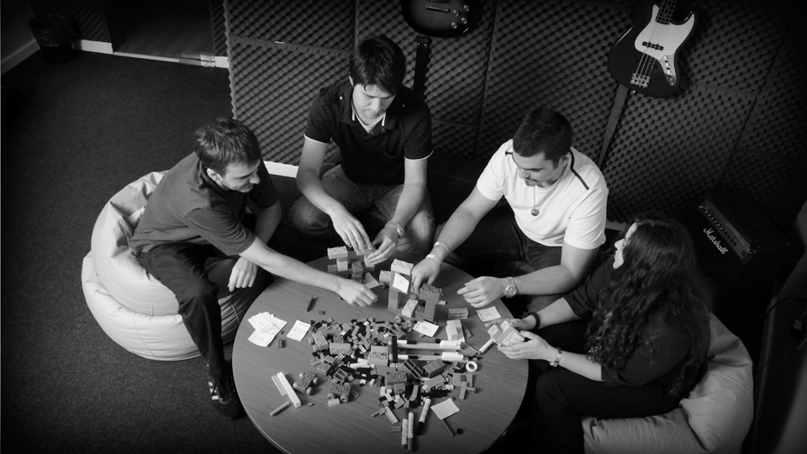




PRODUCT
MANAGER
SOFTWARE
ARCHITECT
ARCH
FRONT/BACK-END DEVELOPER
USER
EXPERIENCE
POC Implementation

Slide 31
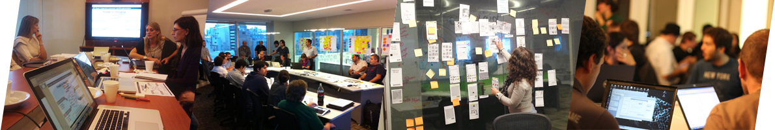







CUSTOMER POC
This is the process we follow to think, design and execute a Blockchain Proof of Concept (POC) at Globant.
PROBLEM
TECHNOLOGY
EXPECTATIONS
DEVELOPMENT
DELIVERY
We want to make sure that we clearly understand the problem to be solved and we evaluate if the the blockchain technology is needed.
If blockchain technology is needed, then we analyze which one is the best to solve the problem.
We agree the objectives and expectations in order to have a clear view on where we need to focus on. The deliverables are also set at this stage.
Execution is done in 3 months by using our proprietary Agile Pods methodology. Strong interaction with our customer team is required.
We deliver the product on time and aligned with the objective of the POC.
Documentation is provided to help the team scale.
Speed, Quality,
Innovation, Autonomy
Notes:
Problem > Understand > check if blockchain technology is required
Technology > Which blockchain technology is the best option?
Expectations > Agree > Objectives and deliverables
Development > Agile Pod Methodology
Delivery > On time + minimum documentation

Slide 32

Database & Virtual Machine
Technology
Distributed & Math-based Trust
This is just the
beginning...
SUMMARIZING

Slide 33
Thanks!
Joaquin Moreno
Blockchain Practice Lead at
Globant
@joaquinmoreno
joaquin.moreno@globant.com
Notes:
Please, If you have any question remember to send them over the webex chat.
Next, We´ll talk about the different blockchains on the market, will talk about the applications and will about about what we are doing here at Globant.

Slide 34
Questions?
Joaquin Moreno
Blockchain Practice Lead at
Globant
@joaquinmoreno
joaquin.moreno@globant.com
Notes:
Please, If you have any question remember to send them over the webex chat.
Next, We´ll talk about the different blockchains on the market, will talk about the applications and will about about what we are doing here at Globant.

Slide 35
Bonus Slides
Notes:
Please, If you have any question remember to send them over the webex chat.
Next, We´ll talk about the different blockchains on the market, will talk about the applications and will about about what we are doing here at Globant.

Slide 36
Source: Bloq

Slide 37
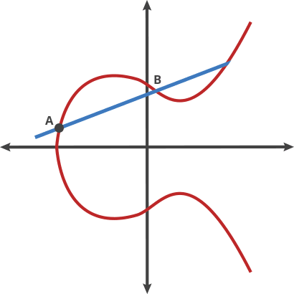


CRYPTOGRAPHICS TECHNIQUES
SHA
256
SHA-256
Elliptic Curves
Proof-of-work
Notes:
SHA 256: proceso unívoco
Curvas Elípticas: Permite obtener 2 números relacionados entre sí.
Proof-of-work: Técnica para evitar Spam (Ataques DOS – Denial Of Service) y de esa forma forzar al sistema

Slide 38
BLOCKCHAIN ECOSYSTEM
Exchanges +
Shapeshift
ETHEREUM
Notes:
Healthcare: also consider “privacy”.

Slide 39
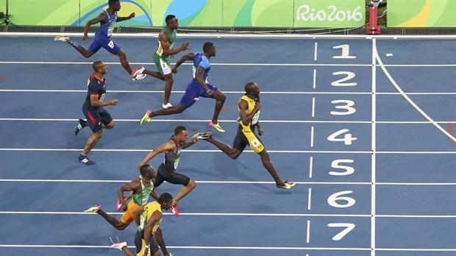
Gaming
Credential Certification (Universities, Trainings)
Legal
IoT (Identification & Communication between devices)
Energy (Efficiency)
Finance (Settlements, trading)
Asset Legitimacy (Art, Jewelry, etc.)
Logistics (Tracking)
Blockchain Race
Notes:
Before going into detail about each of the applications, this is a simplified overview of what I call the Blockchain Race.
Leading the Race we have the Finance industry, later we´ll talk about why this is happening, then we have a batch of other industries….

Slide 40

SHA-256 “101”
Text
Image
SHA
256
2poiuwfsvhxnv382973249j
Doc
“Hash” (fixed size)
Bitcoin
58takañkhfafñjregifñkhskn
SHA
256
Bitcoin.
Bnoqi98738bn5827guhkdl
Notes:
NOTAS:
Hash es de tamaño fijo.
Univoco. Es como si fuese una HUELLA. No se puede volver a atrás.
256 bits de información.

Slide 41
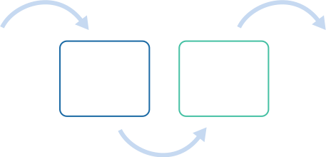
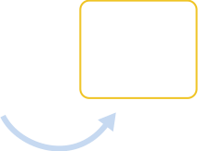
BLOCKCHAIN
Hash #
Height: 418295
hash n-3
hash n-1
Block “n”
Header [hash.header(n-1)]
Metadata
Transactions
hash n-2
hash n
10 min.
Hash Technique:
SHA-256

Slide 42
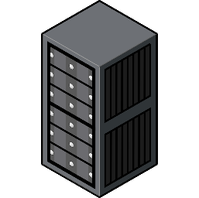

MINING - DIFFICULTY - POW
Block “n”
2poiuwfsvhxnv382249j
SHA
256
Nonce=0
Header:
-Nonce (#)
-[hash.header(n-1)]
-Etc..
00riu398jbnwirut5kfñkj
Nonce=1
0000r398gyakcvncvmd
Nonce=2
t_{avg.}= 10 min
.
.
.
0000000000000000md
Nonce= n (target)
Notes:
Analogía con el sudoku. Dificil de completa pero fácil de verificar.

Slide 43
FINANCIAL USE CASES 1
 | Use Case | Description
1 | Asset Depository | Assets such as financial securities must be able to be dematerialized on a blockchain network, so that all stakeholders of an asset type will have direct access to each asset.
2 | Asset Financing | Assets should always be owned by their actual owners, and assets owners must be able to allow 3rd-party professionals to manage their assets without having to pass legal ownership of assets to 3rd parties.
3 | Custody | The holding of securities and other assets on behalf of a customer. (Maintain the security and ownership of these assets and can be maintained in either physical or digital copies)
4 | Currency Swap | Help borrowers avoid exposure to changes in the exchange rate.
5 | Credit Default Swaps (CDS) | Eliminate replicated business logic and reconciliation among parties to the CDS transaction.
6 | Trade Capturing | Unique database with all the trading settlements. Shared with all the parties involved on the trading process.
Notes:
Proof of Work
Proof of Stake:
Proof-of-stake asks users to prove ownership of a certain amount of currency (their "stake" in the currency). Selection by account balance would result in (undesirable) centralization, as the single richest member would have a permanent advantage. Instead, several different methods of selection have been devised.

Slide 44
FINANCIAL USE CASES 2
 | Use Case | Description
7 | Payments - Interbank | Unified database for settlements and clearing between banks.
8 | Global KYC Database | A unique source of truth for identities
9 | Equity Contracts | Transfer the ownership of the equities
10 | Financial Reference Data | Open financial reference data ledger for global clients, party, product and pricing data
11 | Micro Lending | Small, riskier loans issued in order to satisfy unbanked.
12 | Trade Finance Letter of Credit | Documents trading between the interested parties. (Letter of Credit or Bill of Lading, etc.)
Notes:
Proof of Work
Proof of Stake:
Proof-of-stake asks users to prove ownership of a certain amount of currency (their "stake" in the currency). Selection by account balance would result in (undesirable) centralization, as the single richest member would have a permanent advantage. Instead, several different methods of selection have been devised.

Slide 45
ETHEREUM
Powered by: | Core devolopers + Community
Main Characteristic | Touring Complete, Embedded Programming Language (Solidity), Validation every 15 seconds, Validates Token + Smart Contract processed.
Consensus Algorithm | Proof of Work (PoW) - Soon Proof of Stake
Programing Language | Solidity (Javascript) - Serpent (Python)
Open or Close? | Open
Transaction or Logic? | Logic (Smart Contract)
User cases
Large Files Storage | IPFS
Interfases
Notes:
“blockchain with a built-in Turing-complete programming language”
Blockchain
The main difference between Ethereum and Bitcoin with regard to the blockchain architecture is that, unlike Bitcoin, Ethereum blocks contain a copy of both the transaction list and the most recent state. Aside from that, two other values, the block number and the difficulty, are also stored in the block.
A commonly asked question is "where" contract code is executed, in terms of physical hardware. This has a simple answer: the process of executing contract code is part of the definition of the state transition function, which is part of the block validation algorithm, so if a transaction is added into block B the code execution spawned by that transaction will be executed by all nodes, now and in the future, that download and validate block B.

Slide 46


ETHEREUM ACCOUNTS
Nonce
Account
20-byte Address
Create and
Sign a TX
Externally
Owned
Account
Ether Balance
Message
Contract Code
Nonce
Storage
Ether Balance
Contract Code
Nonce
Storage
Ether Balance
Message
Message
Contract
Account
Contract Code
Storage
Notes:
In Ethereum, the state is made up of objects called "accounts", with each account having a 20-byte address and state transitions being direct transfers of value and information between accounts. An Ethereum account contains four fields:
The nonce, a counter used to make sure each transaction can only be processed once
The account's current ether balance
The account's contract code, if present
The account's storage (empty by default)
"Ether" is the main internal crypto-fuel of Ethereum, and is used to pay transaction fees. In general, there are two types of accounts: externally owned accounts, controlled by private keys, and contract accounts, controlled by their contract code.
An externally owned account has no code, and one can send messages from an externally owned account by creating and signing a transaction;
in a contract account, every time the contract account receives a message its code activates, allowing it to read and write to internal storage and send other messages or create contracts in turn.
Note that "contracts" in Ethereum should not be seen as something that should be "fulfilled" or "complied with"; rather, they are more like "autonomous agents" that live inside of the Ethereum execution environment, always executing a specific piece of code when "poked" by a message or transaction, and having direct control over their own ether balance and their own key/value store to keep track of persistent variables.
SMART CONTRACT

Slide 47
Sender
Signature
Ether
Amount
Recipient
Sender
Ether
Amount
Recipient
Data (optional)
STARTGAS (max steps)
Data (optional)
STARTGAS (max steps)
GASPRICE (fee)
TRANSACTION / MESSAGE
Transaction
Message
produced by an externally owned account
produced by a contract account
Notes:
The term "transaction" is used in Ethereum to refer to the signed data package that stores a message to be sent from an externally owned account. Transactions contain:
The recipient of the message (Contract Address - Solo se puede un contrato de destino. Se puden hacer varios en serie, pero no en paralelo)
A signature identifying the sender
The amount of ether to transfer from the sender to the recipient
An optional data field (aquí se le pone a que funcion (solo se puede una sola función) y que variables atacar en el contrato.)
A STARTGAS value, representing the maximum number of computational steps the transaction execution is allowed to take
A GASPRICE value, representing the fee the sender pays per computational step
The first three are standard fields expected in any cryptocurrency. The data field has no function by default, but the virtual machine has an opcode with which a contract can access the data; as an example use case, if a contract is functioning as an on-blockchain domain registration service, then it may wish to interpret the data being passed to it as containing two "fields", the first field being a domain to register and the second field being the IP address to register it to. The contract would read these values from the message data and appropriately place them in storage.
The STARTGAS and GASPRICE fields are crucial for Ethereum's anti-denial of service model. In order to prevent accidental or hostile infinite loops or other computational wastage in code, each transaction is required to set a limit to how many computational steps of code execution it can use. The fundamental unit of computation is "gas"; usually, a computational step costs 1 gas, but some operations cost higher amounts of gas because they are more computationally expensive, or increase the amount of data that must be stored as part of the state. There is also a fee of 5 gas for every byte in the transaction data. The intent of the fee system is to require an attacker to pay proportionately for every resource that they consume, including computation, bandwidth and storage; hence, any transaction that leads to the network consuming a greater amount of any of these resources must have a gas fee roughly proportional to the increment.
MESSAGE
Essentially, a message is like a transaction, except it is produced by a contract and not an external actor. A message is produced when a contract currently executing code executes theCALL opcode, which produces and executes a message. Like a transaction, a message leads to the recipient account running its code. Thus, contracts can have relationships with other contracts in exactly the same way that external actors can.
Note that the gas allowance assigned by a transaction or contract applies to the total gas consumed by that transaction and all sub-executions.
Message is not stored on the blockchain. Only the transactions does.

Slide 48
ROOTSTOCK
Powered by: | Core company (20% of the fees paid by the users) + Community
Main Characteristic | Use Bitcoin as the native coin, 2-way-peg (sidechain: rootstock, bitcoin: federation with miners and companies, create a High volume blockchain 300 tps . trade off with decentralize). The votes distribution is variable between the miners and federation.
Consensus Algorithm | Merge Mining (Bitcoin miners use same hardware for mining bitcoin to other coins).
Programing Language
Open or Close? | Open Source (Sep’16)
Transaction or Logic? | Logic
User cases | Financial Inclusion, Banks,
Large Files Storage
Interfases
Notes:
Federated peg vs Fully centrilized peg
Federated peg: Notaries has a multisignature. To send Bitcoins send it to an exit address.
BTC -> RSK: is automatically
RSK -> BTC: requires help from the federation. (Federators cannot choose the output nor the destination address. Is managed by a smart contract)
BridgeMaster¿?
Federators: many places in the world. Needs some securities to protect the private keys of the multisig wallet.
Scalability:
Storage is the main limitation.
Sidechain: One blockchain evaluates the consensus algorithm of the other blockchain
Sidechain + Merge Mining system:
Allow miners to vote in state of the other blockchain.
BIP: http://bit.ly/29jLs9j
VM: compatible with Ethereum VM (ethereumj).
Can run an ethereum contract on the RSK VM.
Business Model:
20% of the fees users pays.

Slide 49
HYPERLEDGER
Powered by: | IBM, Cisco, Blockstream, Digital Assets Holding, DTCC, BNP Paribas,
Main Characteristic | Modules, “Plug & Play”
Consensus Algorithm | Various (TBD)
Programing Language
Open or Close? | Open + Closed
Transaction or Logic? | Transactions + Smart Contract
User cases | Assets Depositary, Currency Swaps, Equity Contracts,
Large Files Storage | off-chain
Interfases | pub/sub event management framework which enables external applications to monitor and be alerted to ledger events.

Slide 50
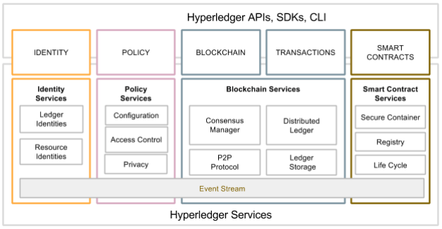
HYPERLEDGER
Notes:
Source with more details (WhitePaper): https://docs.google.com/document/d/1Z4M_qwILLRehPbVRUsJ3OF8Iir-gqS-ZYe7W-LE9gnE/pub
Identity services manages identities of entities, participants and ledger objects such as assets and smart-contracts.
Policy services manages access control, privacy, consortium rules, consensus rules, etc. (The policy services function enables the configuration and management of system policies)
Blockchain services manage the distributed ledger through a peer-to-peer communication protocol. The data structures are optimized to provide efficient schemes for maintaining the world state replicated at many participants. Different consensus algorithms guaranteeing strong consistency (tolerating misbehavior with BFT, tolerating delays and outages with crash-tolerance, or tolerating censorship with proof-of-work) may be plugged in and configured per deployment.
Smart-contract services are a secured and lightweight way to sandbox the smart-contract execution on validating nodes. The environment is a "locked down" and secured container with a set of signed base images.
Consensus Manager is an abstraction that defines the interface between the consensus algorithm and the other Hyperledger components. Consensus Manager receives transactions, and depending on the algorithm, decides how to organize and when to execute the transactions. Successful execution of transactions results in changes to the ledger.
By supporting a modular pluggable consensus function, Hyperledger supports the configuration of different types of consensus modules designed for specific threat/security models.
Each module type of Hyperledger has a clear, well defined API so that Hyperledger algorithms can be used in a manner that is as “plug-and-play” as possible

Slide 51
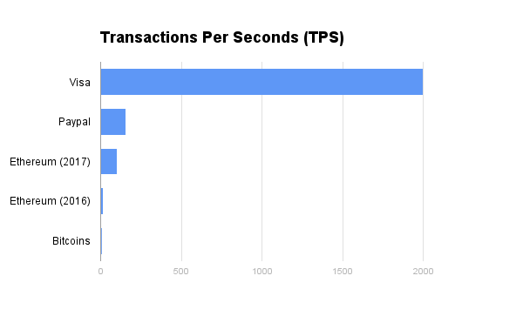
CHALLENGES
Scalability
Notes:
Bitcoins 5 to 7
Ethereum (Jun 2016) average: 15
Ethereum (2017): 100
Paypal: 155
Visa: 2000

Slide 52
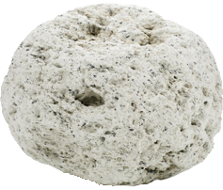


Databases Costs
Running and Maintenance
Costs
Confidentiality
Current
Solutions
Private
Blockchain
Public
Blockchain
Notes:
Confidentiality: no one shall be able to deduce others’ trading behaviors by analyzing the ledger. In another word, an investor can only interrogate the balance of his/her own account book.

Slide 53
TRANSACTION
Input
Amount
Output
Transaction
from A to B
A
B
0.45
Bitcoin Transaction
Output
Input
Monto
Output
0.45
1294fjdfj…
1294fjdfj…
1ptpoigeu…
Parámetros
N_LOCK_TIME
OP_RETURN (80bytes)
Notes:
Transacción común: es in paquete de información, que contienes una entrada/input, una salida/output y un monto.
Transacción de bitcoin: contiene los mismos elementos con 2 particularidades claves. 1) Se le pueden agregar parámetros con más información en cada transacción.
N_LOCK_TIME: que una transacción se ejecute luego de un cierto período de tiempo
OP_RETURN: un comando para agregar información a cada transacción (Se crea un output con esa información)

Slide 54
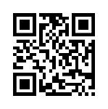



KEYS GENERATION
SHA 256
SHA 256
Elliptic Curves
RIPEMD160
Random
Number
256-bit
Private
Key
Public
Key
Bitcoin
Address (public)
QR
Code
Reliable source
of randomness
1iada439ALej…

